Slide 1

EE 272 Digital Systems-Fall 2019
Instructor: Dr. Aashir Waleed
Lecture 1 – 1
Chapter 1 Binary Number

Slide 2
Lecture Overview
Lecture 1 – 2
 Number systems & Binary number representation
 Number-base conversions
 Hexadecimal numbers
 Signed Binary Numbers
 Two’s complements
 Binary Codes (BCD, Gray,ASCII,…)

Slide 3
Number System
ELEC2200 Fall 2014 – L.Yobas
Lecture 1 – 3
 Decimal number – base 10 (radix 10)
 10 digits (0,1,2,3,4,5,6,7,8,9)
 Digital positions are weighted with powers of 10
a a □ a a a = a 10^{n−1} + a 10
n− 2 1
0
+☹+ a 10 + a 10
n−1 n− 2 2 1 0 n−1 n− 2 1 0
E.g.
438 = 4 ×10² + 3 ×10¹ + 8 ×10⁰ = 400 + 30 + 8
10
 In general – base r (radix r)
 r digits: (0,1,…,r-1). Position weighted with powers of r
(a a □ a a a ) = a
_{r}n−1 _{+ a}
n− 2 1 0
r +☹+ a r + a r
n−1 n− 2 2 1 0 r n−1 n− 2 1 0
E .g. 245 = 2 × 8² + 4 × 8¹ + 5 × 8⁰ = 2 × 64 + 4 × 8 + 5 = 165
8
 Binary number – base 2 (radix 2)
 2 digits: {0,1} . Position weighted with powers of 2
₂n−1 _{+ a}
n− 2 1 0
^{(a}n−1ªn− 2^{□ a}2ª1ª0⁾2 ^{= a}n−1
2 +☹+ a 2 + a 2
n− 2 1 0
E .g. 110111 = 1× 2⁵ +1× 2⁴ + 0 × 2³ + 1× 2² + 1× 2¹ + 1× 2⁰ = (55)
2
10

Slide 4
Method of converting Decimal Integer to Base r
 Divide the decimal number by r to obtain integer quotient and a remainder
 Repeat this for the integer quotient, again and again, until you reach zero quotient
 The remainders give you the digits in base r number
 E.g. (72)₁₀ = (?)₂
2 72
2 36 …. 0
2 18 …. 0
(72)₁₀ =(1001000) ₂
2 9
…. 0
Verify: (1001000) ₂
= 1*64+1*8 = 72
2 4
…. 1
2 2
…. 0
…. 0
2
1
0
…. 1

Slide 5
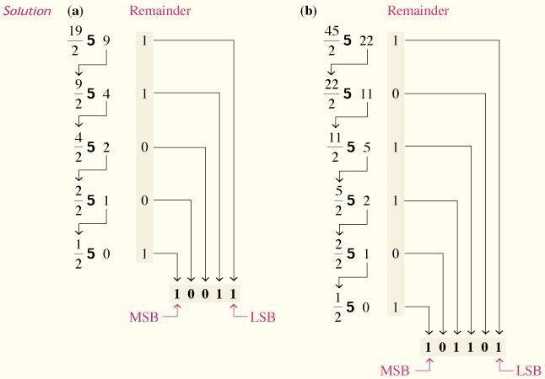
“Repeated division by 2” method
Lecture 1 – 5
 Most significant bit (MSB) – the left most bit
 Least significant bit (LSB) – the right most bit
Floyd, Digital Fundamentals

Slide 6
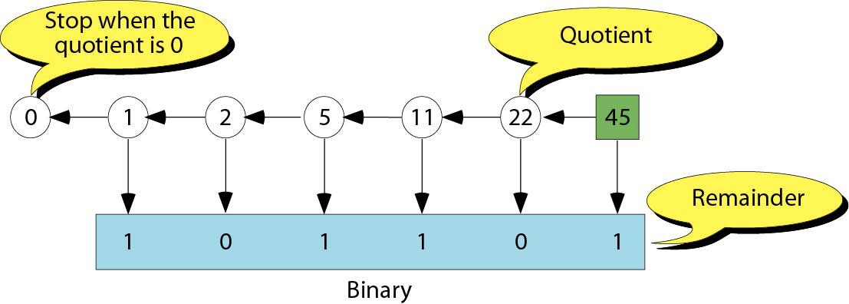
“Repeated division by 2” method
Lecture 1 – 6
Floyd, Digital Fundamentals

Slide 7
“Sum of weights” method
Lecture 1 – 7
₂8 | ₂7 | ₂6 | ₂5 | ₂4 | ₂3 | ₂2 | ₂1 | ₂0 | =
256 | 128 | 64 | 32 | 16 | 8 | 4 | 2 | 1 | =
0 | 0 | 1 | 0 | 0 | 1 | 0 | 0 | 0 | 72
0 | 0 | 0 | 1 | 0 | 0 | 0 | 0 | 1 | 33
0 | 1 | 0 | 1 | 0 | 0 | 1 | 1 | 1 | 167

Slide 8
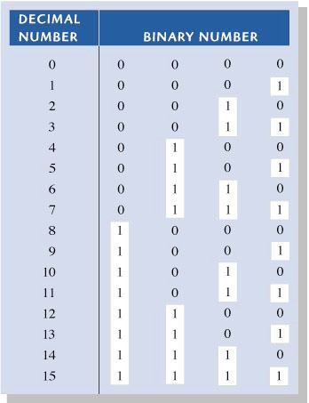
“Sum of weights” method
Lecture 1 – 8
8 | 4 | 2 | 1
With n = 4 bits
You can represent total 2^{n} = 2⁴ = 16
from 0 up to 2⁴ – 1 =15
Floyd, Digital Fundamentals

Slide 9
How about non-integer numbers
Lecture 1 – 9
 Use negative powers of r
n−1 1 0 −1 −2
_{r}−m
(a_{n−1}□ a₁a₀.a₋₁a₋₂...a_{− m} )_{r} = a_{n−1}r ☹+ a r + a r + a r + a r + ... + a
1 0 −1 −2 − m
E .g.
2 1 0 −1 −2
245.34 ₈ = 2 × 8 + 4 × 8 + 5 × 8 + 3 × 8 + 4 × 8
= 2 × 64 + 4 × 8 + 5 + 3 × 0.125 + 4 × 0.015625 = 165.4375
E .g. (1011.011) = 1× 2³ + 1 × 2¹ + 1× 2⁰ + 1× 2⁻² + 1 × 2⁻³ = (11.375)
2 10
Converting decimal number to base-r is done by converting separately the integer part, and the fractional part, and combining the answers of r
The algorithm for conversion of decimal fraction to base r
Multiply fraction by r
Integer part of the result is the first coefficient
Multiply the new fraction by r to obtain the next coefficient
And so on, until fraction becomes 0

Slide 10
Example of converting non-integer
Lecture 1 – 10
 (0.4375)₁₀ = (?)₂
0.4375 * 2 = 0.875 : <1 ➔ 0
0.875 * 2 = 1.75 : >1
0.75 * 2 = 1.5 : >1
0.5 * 2 = 1.0 : =1 ➔ 1
➔ 1 *(1.75-1) = 0.75
➔ 1 *(1.5-1) = 0.5
 (0.4375)₁₀ = (0.0111)₂

Slide 11
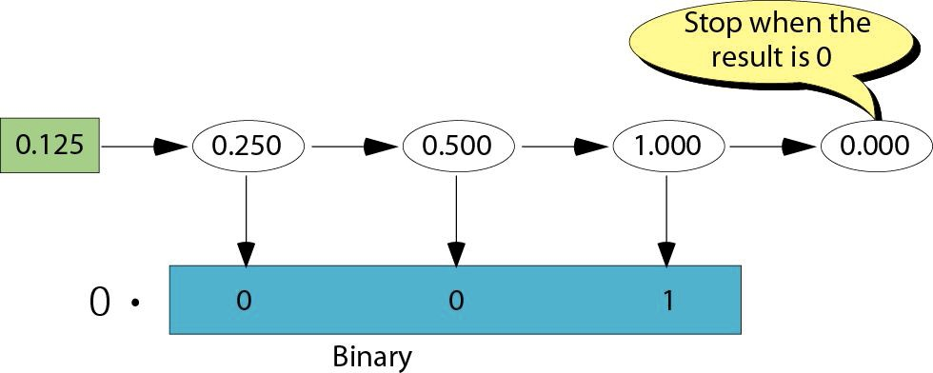
Example of converting non-integer
Lecture 1 – 11
Floyd, Digital Fundamentals

Slide 12
Example of converting non-integer
Lecture 1 – 12
8 | 4 | 2 | 1 | 1/2 | 1/4 | 1/8 | 1/16 | =
1 | 0 | 1 | 1 | 0 | 1 | 1 | 0 | 11.375
0 | 0 | 0 | 0 | 0 | 1 | 1 | 1 | 0.4375
0 | 0 | 1 | 1 | 0 | 0 | 0 | 1 | 3.0625

Slide 13
Some terminology for binary number
Lecture 1 – 13
 Bit – binary digit – a single binary number
 Byte – a 8-bit binary number
 Word – a number formed by multiple number of bits.
 16-bit word – 2-byte word
 32-bit word – 4-byte word
 Most significant bit (MSB) – the left most bit of a n-bit word
 Least significant bit (LSB) – the right most bit of a n-bit word
 E.g. A 16-bit (2-byte) word 1000100100010001
MSB
LSB

Slide 14
Hexadecimal Number
Lecture 1 – 14
 Hexa – Base 16 – a simpler form to write a binary number
 16 digits : {0,1,2,3,4,5,6,7,8,9} Add
{A=10,B=11,C=12,D=13,E=14,F=15}
 E.g. (4AC)₁₆=4*16²+10*16+12*1 =1196
 Hexadecimal numbers are typically used as a “shortcut” notation for binary numbers, there are four bits per hex digit, hence the conversion of even a long binary number into hexadecimal and vice-versa, is quick & simple:
 E.g. (110110100011)₂ = 1101 1010 0011 = (DA3)₁₆
 (ABC3)₁₆ = (1010 1011 1100 0011)₂
 Similarly base 8 (octal) uses a 3 bit groups
 E.g. (257)₈ = (010 101 111)₂
 Notation for hexa number: h2B, x2B, 0x2B 2Bh
Decimal | Hex | Binary
0 | 0 | 0000
1 | 1 | 0001
2 | 2 | 0010
3 | 3 | 0011
4 | 4 | 0100
5 | 5 | 0101
6 | 6 | 0110
7 | 7 | 0111
8 | 8 | 1000
9 | 9 | 1001
10 | A | 1010
11 | B | 1011
12 | C | 1100
13 | D | 1101
14 | E | 1110
15 | F | 1111

Slide 15





Binary arithmetic
Lecture 1 – 15
 Addition – similar to decimal number
0 1 1
1 3 7 8
1
0 1
1 1 1 1 1 1 1
Binary:
1 0 1 1 0 1 1
+ 5 9 2 | + 0 1 | + 0 1 1 0 1 0 1
1 9 7 0 | 1 0 | 1 0 0 1 0 0 0 0
 Multiplication– similar to decimal number
1 7 1 0 1
9 2 ^{X} 0 1 1
X
0 0 0
1 0 1
1 0 1
0 1 1 1 1

Slide 16





















How about subtraction?
Lecture 1 – 16
Binary:
9 9
1 1 10
0 10 1 13
10
0
1 0
– 0 1 – 0 0 1 1 1 1
0 1 0 1 0 1 1 0
0
0 10 1 10
0
0
1 0 0 3
1 0 0 1 0 1
– 0 5 4 6
0 4 5 7
For A >= B,A-B =C and C is positive, so there is no problem. How about if A < B
0 5 4 6
-
₋ 0 0 1 1 1 1
1 0 0 3
1 0 0 1 0 1
The number is negative, how do we represent the negative number?

Slide 17
Signed binary number representation
Lecture 1 – 17
 Use Most Significant Bit (MSB) to indicate the sign
 MSB = 0 indicates positive number
 MSB = 1 indicates negative number
 Three different representations
 Signed magnitude ← Least used
 MSB: sign, other bits represent the magnitude
 N = a₇a₆a₅a₄a₃a₂a₁a₀
 Sign bit: a₇
 E.g. -69 => 69 = 01000101=> -69 = 11000101
 Signed complement (1’s complement)
 Signed complement (2’s complement) ← Most important

Slide 18
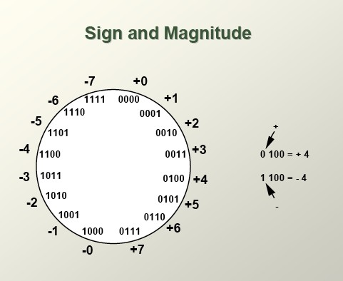
Signed binary number representation
Lecture 1 – 18
Floyd, Digital Fundamentals

Slide 19
Complement number
Lecture 1 – 19
 Complements are used to simpifly subtraction
 Lead to simpler, less expensive circuits to implement operations such as addition and subtraction
 2 types of complement – 1’s complement and 2’s complement
 For a n-bit number
 2’s complement of a number x means 2^{n}-x
 1’s complement of a number x means 2^{n}-1 –x
 For a n-bit number, the carry generate at the MSB to the n+1 bit location is discarded
 E.g. for a 8-bit number, let x = 01101001
 2’s complement of x = 100000000-01101001 = 10010111
 1’s complement of x = (100000000-1)-01101001=11111111- 01101001 = 10010110
 Method of generating 1’s complement number
 Easy, Invert all the bits

Slide 20
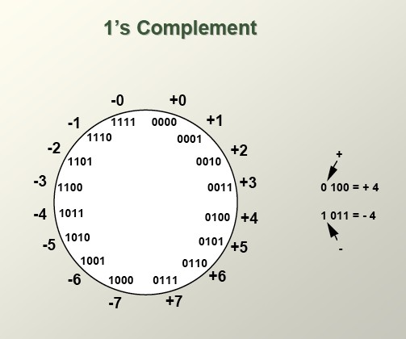
Signed binary number representation
Lecture 1 – 20
Floyd, Digital Fundamentals

Slide 21

Generating 2’s complement number
Lecture 1 – 21
 Invert all bits and add one (2’s complement = 1’s complement +1)
 Example:
 34 -> 00100010
 Inverted => 11011101
 +1 => 11011110 => -34
 This works both ways
 To negative a negative number, get its 2’s complement
 -34 => 11011110
 Inverted =>00100001
 +1 => 00100010 => 34
 Another method – leave all less significant (right side) 0’s and the first 1 unchanged and then invert all other bits
18 => 00010010
-18 => 11101110

Slide 22
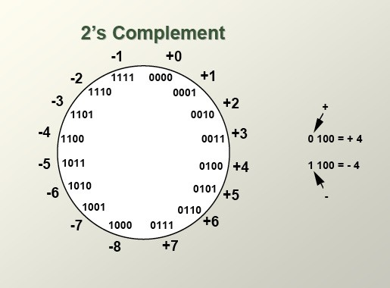
Signed binary number representation
Lecture 1 – 22
Only one representation for 0
One more negative number than positive number
Floyd, Digital Fundamentals

Slide 23
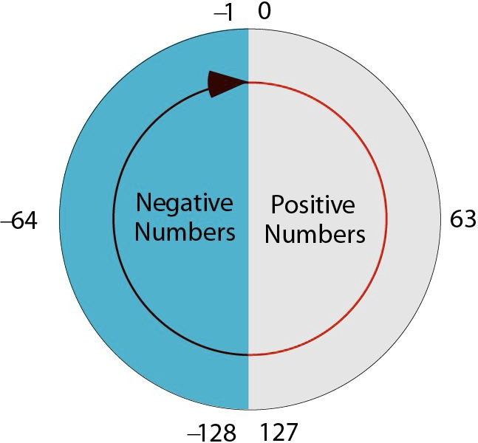
2’s complement numbers
Lecture 1 – 23
Floyd, Digital Fundamentals

Slide 24
Addition of 2 2’s complement number
Lecture 1 – 24
 Keep two numbers the same bit size
 Follow normal rules for binary addition
 Example: (-7)+5
1001
+ 0101
1110
–0010
 Remember – all numbers are either ‘signed’ or ‘unsigned’, computation are the same, i.e. hardware does not need to know this,

Slide 25
Subtraction with 2’s Complement
Lecture 1 – 25
 Subtraction using borrowing concept is not easy to implemented in digital hardware
 SO subtraction in digital hardware use complements
 Subtraction of two n-digit unsigned number M-N
 Add M with 2’s complement of N
 M-N= M+(2^{n}-N) = M-N + 2^{n}
 If M >= N, we have M-N+ 2^{n} = M-N since 2^{n} will be discarded for the n- bit number
 If M < N, M-N + 2^{n}= 2^{n} – (N-M) = - (N-M) and hence get the correct value.
 So we can use add the 2’s complement of a number to implement the subtraction.
 Advantage of 2’s complement, can use adder to implement subtraction

Slide 26
Example of 2’s complement subtraction
ELEC2200 Fall 2014 – L.Yobas
Lecture 1 – 26
 E.g 8-bit number 4 – 9
 4 = 00000100, 9 = 00001001, -9 (2’s complement) = 11110111
4
- 9
-5
00000100
+ 11110111 11111011
– 00000101
It works the same way whatever sign the numbers are..
One common hardware for “adding” and “subtracting”!
SO 2’s complement number is most commonly used in digital logic and computer

Slide 27
Can we use 1’s complement to do subtraction?
Lecture 1 – 27
 Take an example, 8-bit number
 5 = 00000101, -5 (1’s complement) = 11111010
 8 = 00001000 -8 (1’s complement) = 11110111
8 – 5 = ?
11111010
+00001000
5 – 8 = ?
00000101
+11110111
11111100
5
+8
13
00000101
+00001000
00001101
-5
+8
3
5
+-8
-3
1 00000010
+ 1
–00000011
00000011
Needs to
add the carry
Bit to get the right answer
–8 –8 = ?
11110111
+11110111 111101110
+ 1
8 – 8 = ?
-8
+-8
-16
8
+-8
0
00001000
+11110111
11111111
0 = 00000000 = 11111111
11101111
In 1’s complement, “0” is represented by 2 different number, not vey good
–00010000

Slide 28
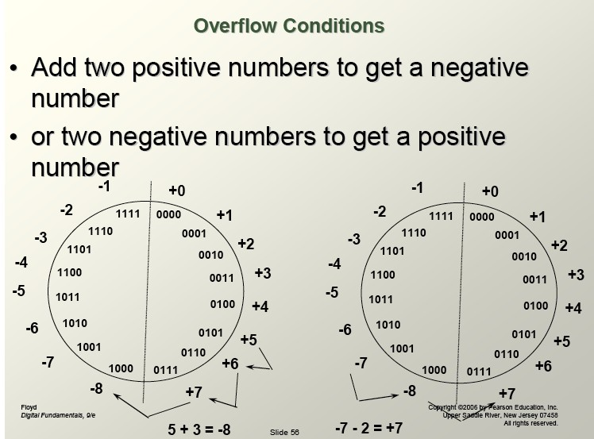
Lecture 1 – 28
Floyd, Digital Fundamentals

Slide 29
Binary Number Ranges
Lecture 1 – 29
 Binary number value depends on interpretation (signed or unsigned)
 E.g. 1001
 Unsigned => 9
 Signed (2’s complement) =>-7
 Number range
 8-bit number
 Unsigned: 0 to 255
 Signed: -128 to 127
 N-bit number range
 Unsigned: 0 to 2^{N} – 1
 Signed: -2^{N-1} to 2^{N-1} -1

Slide 30
Binary Code
Lecture 1 – 30
 Using different combination of binary digit to code a number
 Straight binary code – using smallest number of bit to represent a number
 n-bit binary code has 2^{n} different combinations of 0’s and 1’s
 Number N contains => minimum number of bits = log₂(N)
 Some binary codes will use more than minimum number of bits to represent the number

Slide 31
BCD
Lecture 1 – 31
 Binary coded Decimal - BCD
 Interested in represent decimal digital using 0’s and 1’s
 Each decimal digit is represented by 4 bits
 E.g. (387)₁₀ = (0011 1000 0111)_{BCD}

Slide 32
Gray code
Lecture 1 – 32
 Use in applications in which the normal sequence of binary numbers may produce an error or ambiguity during the transition from one number to the next
 E.g. 4-bit number change from 7 to 8
 Normal sequence: 0111 to 1000
 If every bit has different speed of transition, we may go through different transition scenarios
 E.g. 0111->1111->1011->1001->1000 or 0111->0011->0001-
>0000->1000
 For Gray code: 0100->1100, only 1 bit changes, there is one and only one transition and hence no ambiguity.

Slide 33
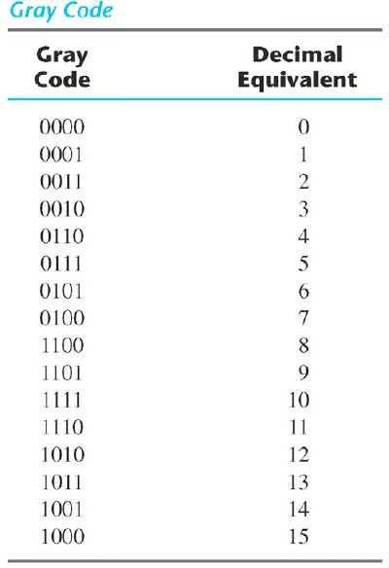
Example of gray code
Lecture 1 – 33
 Only 1 bit changes when counting
 Non-weighted code
 Reflected binary code

Slide 34
Conversion
Lecture 1 – 34
Binary to Gray
+
+
+
+
1 1
0
1
1
Binary
1 0
Gray to Binary
1
1
0
Gray
1 1
0
1
1
Gray
+
+
+
+
1 0
Floyd, Digital Fundamentals
0
1
0
Binary

Slide 35
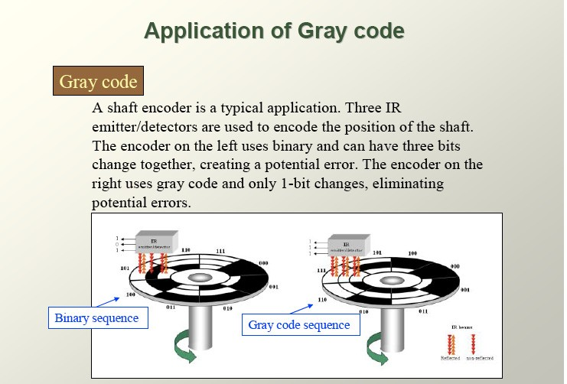
Lecture 1 – 35
Example of gray code
Floyd, Digital Fundamentals

Slide 36
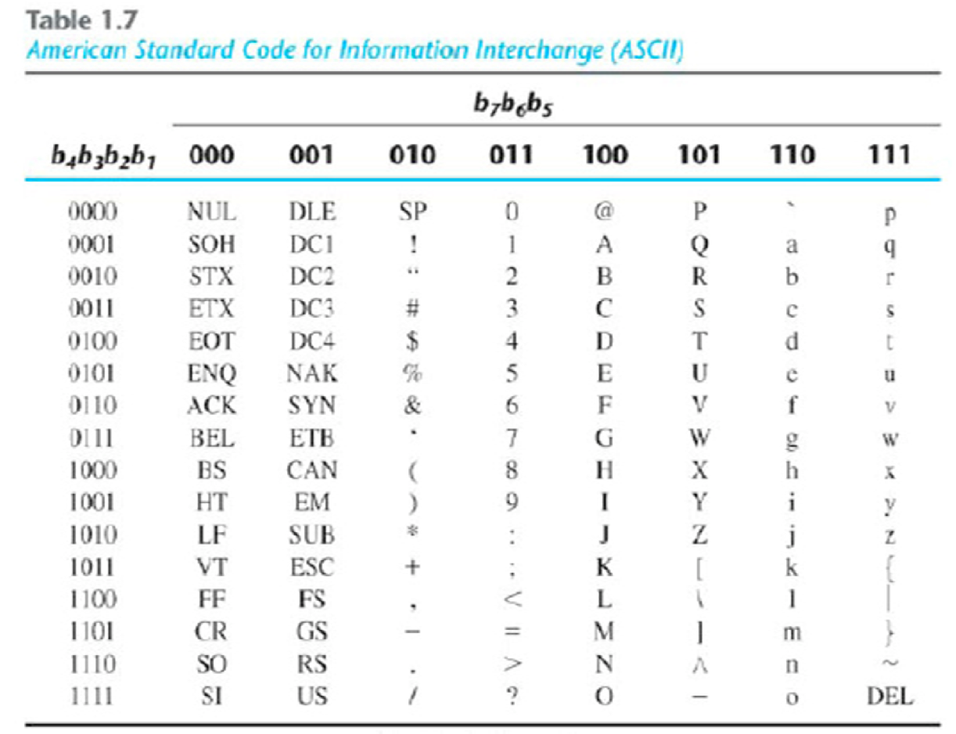
ASCII Code
Lecture 1 – 36
 Stand for American Standard Code for Information Interchange (ASCII)
 Use 7-bit binary code to represent the common alphabet and symbols

Slide 37
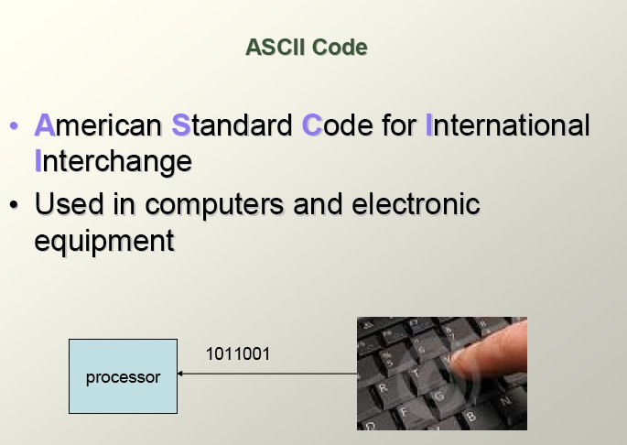
Lecture 1 – 37
ASCII Code
Floyd, Digital Fundamentals

Slide 38
Other Binary code
Lecture 1 – 38
 Thermometer code
 Add one more ‘1’ in each consecutive code, like the thermometer indication
Thermometer code
0000001
0000011
0000111
0001111
0011111
0111111
1111111
 One-hot code
 Each code only has 1 ‘1’, all the others are ‘0’
 Different code has different location of the ‘1’
One-hot code
0000001
0000010
0000100
0001000
0010000
0100000
1000000

Slide 39
Reading Assignment
Lecture 1 – 39
 Chapter 1.1 – 1.8 of textbook
 Next topic
 Boolean algebra and logic gate
 Chapter 1.9 and 2 of text book

